Slide 1

Statistiques avec
M2 Sciences du Langage
Rémi Lafitte
2023-2024

Slide 2

Plan
TD1 10/11 - Introduction à R
TD2 17/11 - Statistiques descriptives sur R
TD3 24/11 - Statistiques inférentielles sur R (1)
TD4 01/12 - Statistiques inférentielles sur R (2)
TD5 08/12 - Statistiques inférentielles sur R (3)
TD6 15/12 - Aller plus loin : Rmarkdown et ggplot

Slide 3

TD 1 10/11/2023 Introduction à R
https://allisonhorst.com/r-slack-emoji

Slide 4
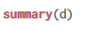
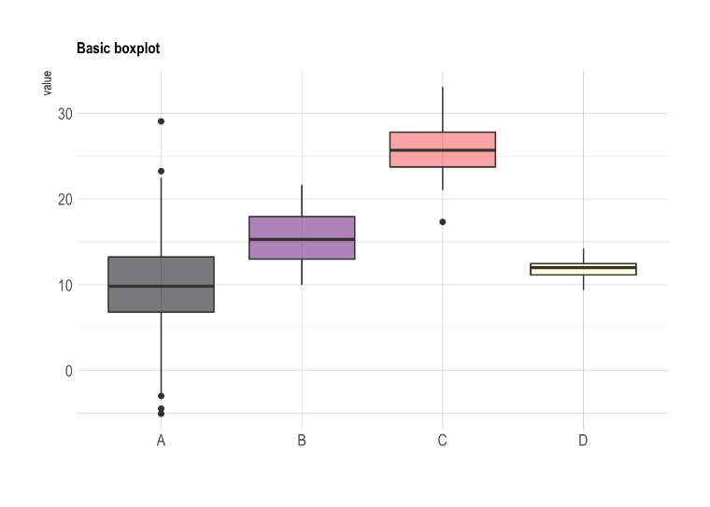
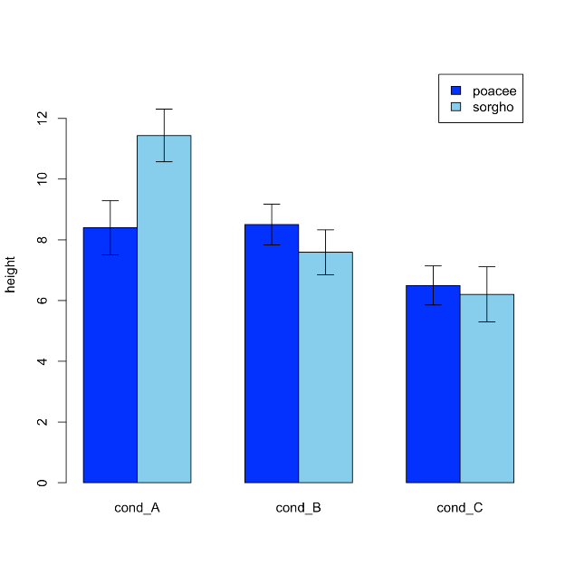
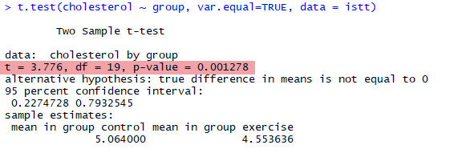
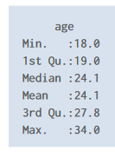
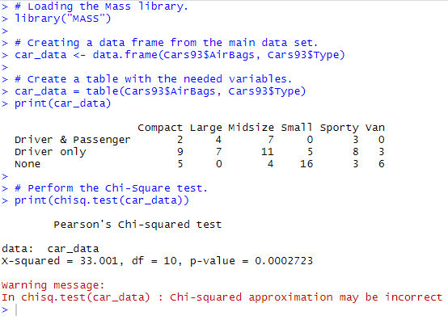
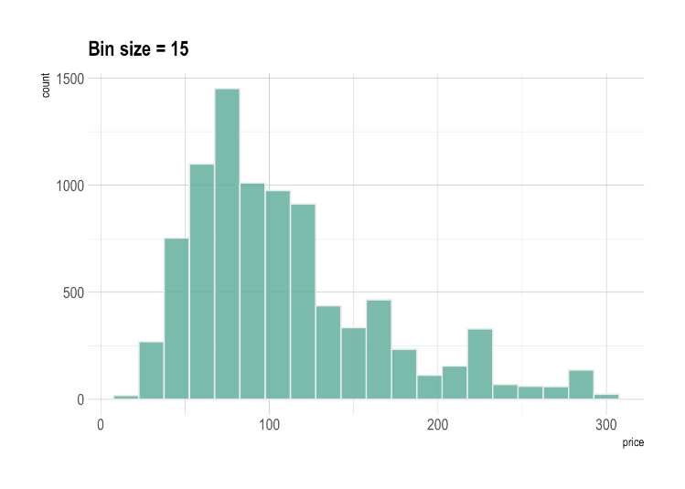
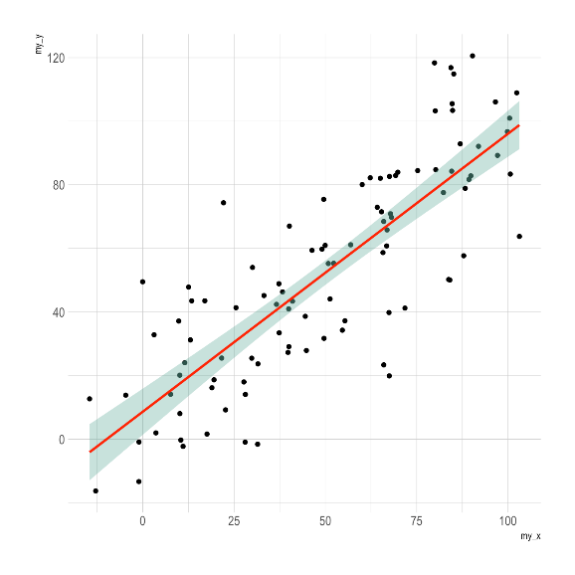
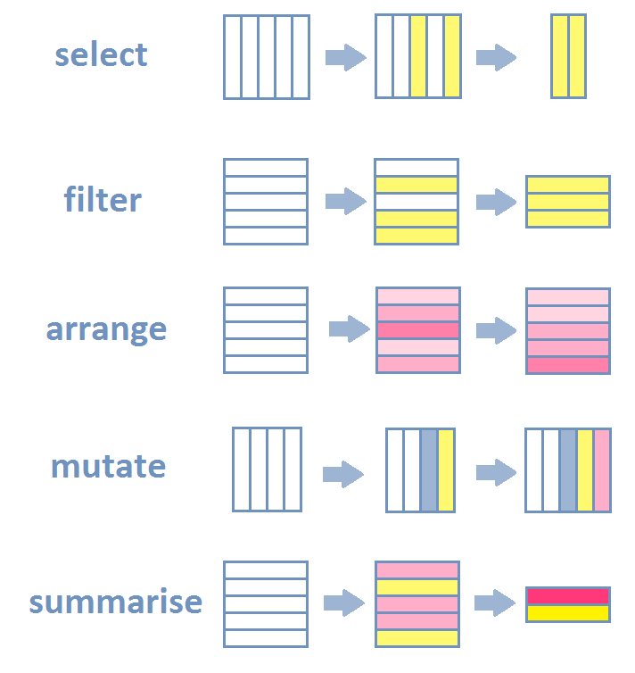
Pourquoi R ?
On peut presque tout faire avec R
Stat descriptives et inférentielles
Graphiques
Manipuler des jeux de données complexes
https://r-graph-gallery.com/
https://scholar.google.com/scholar?hl=fr&as_sdt=0%2C5&as_ylo=2019&q=popularity+R+statistical+software&btnG=
https://www.ncbi.nlm.nih.gov/pmc/articles/PMC7872865/pdf/cureus-0013-00000012639.pdf
À peu près 11000 articles
https://www.ncbi.nlm.nih.gov/pmc/articles/PMC10090872/pdf/rsos.221550.pdf#bmk_RSOS221550C23
https://flowingdata.com/2016/03/22/comparing-ggplot2-and-r-base-graphics/

Slide 5
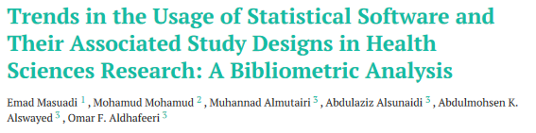
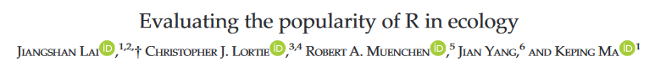
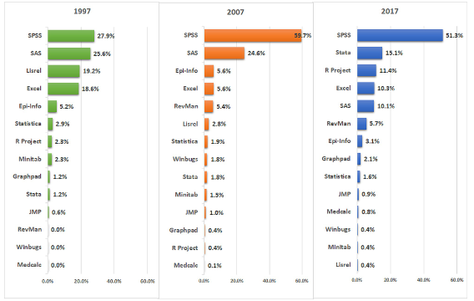
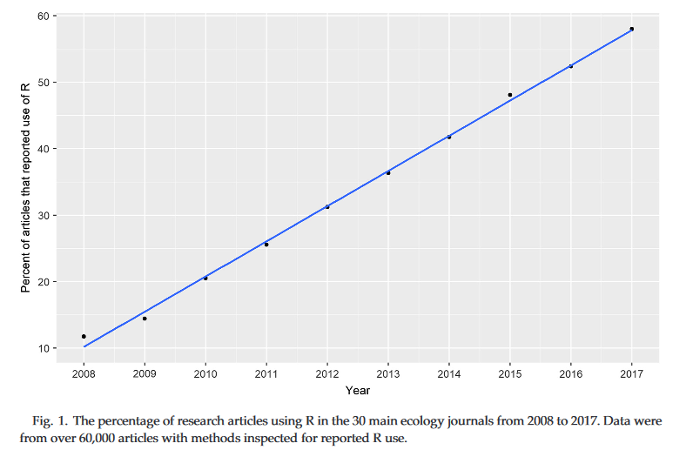
Pourquoi R ?
De plus en plus adopté par les scientifiques
https://scholar.google.com/scholar?hl=fr&as_sdt=0%2C5&as_ylo=2019&q=popularity+R+statistical+software&btnG=
https://www.ncbi.nlm.nih.gov/pmc/articles/PMC7872865/pdf/cureus-0013-00000012639.pdf
À peu près 11000 articles
https://www.ncbi.nlm.nih.gov/pmc/articles/PMC10090872/pdf/rsos.221550.pdf#bmk_RSOS221550C23
https://flowingdata.com/2016/03/22/comparing-ggplot2-and-r-base-graphics/

Slide 6
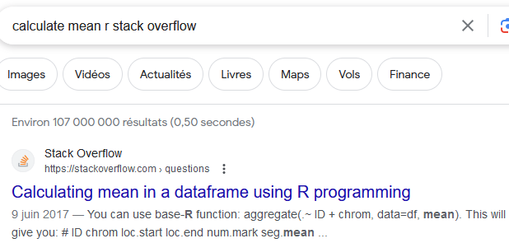

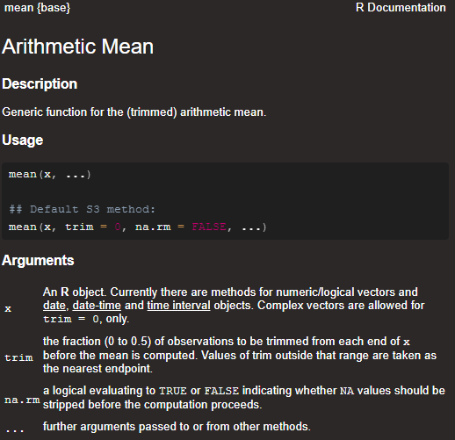

Pourquoi R ?
Large documentation
Stack overflow
Autres sites, blogs…
Livres…
Ce qui vous attend
LE classique
Documentation de qualité dans R
https://r4ds.hadley.nz/

Slide 7
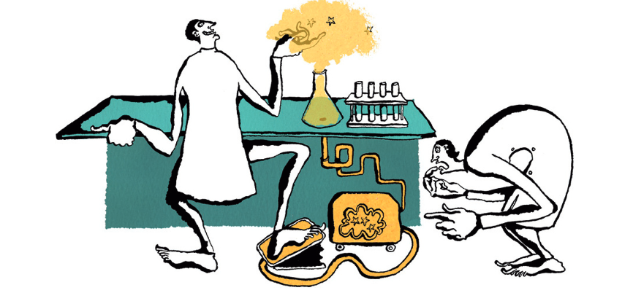
Pourquoi R ?
Reproductibilité computationnelle
“Reproducing the result of a computation means running the same software on the same input data and obtaining the same results” p.2
“Replicating a published result means writing and then running new software based on the description of a computational model or method provided in the original publication, and obtaining results that are similar enough to be considered equivalent” p.3
https://www.nature.com/articles/nj7396-137a
Rougier, N. P., Hinsen, K., Alexandre, F., Arildsen, T., Barba, L. A., Benureau, F. C. Y., et al. (2017). Sustainable Computational Science: The ReScience Initiative. Available online at: https://arxiv.org/abs/1707.04393
https://jamanetwork.com/journals/jama/fullarticle/2752474
The identified programming error […] occurred while the variable referring to the study “arm” (ie, group) assignment was recoded. The purpose of the recoding was to change the randomization assignment variable format of “1, 2” to a binary format of “0, 1.” However, the assignment was made incorrectly and resulted in a reversed coding of the study groups …
[…] As noted here, this reanalysis showed reversed study findings […]

Slide 8
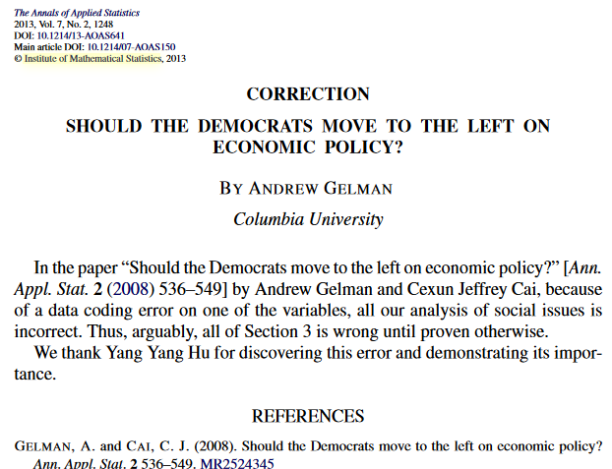
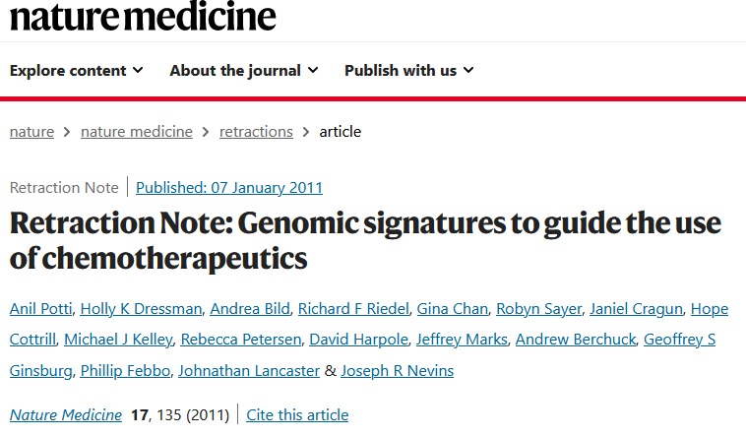
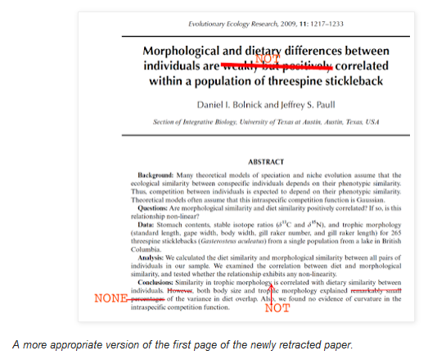
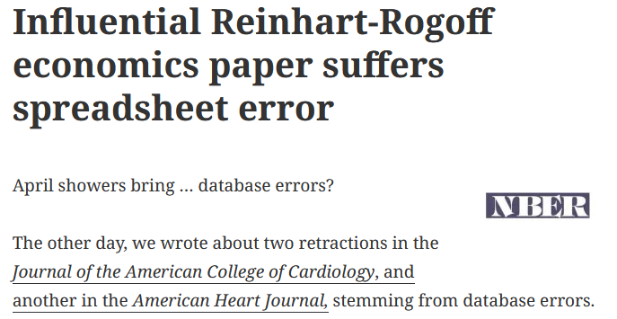

Pourquoi R ?
Reproductibilité computationnelle
Permet de repérer les erreurs
Corrections (ou rétractation) si besoin
Erreurs de codage
Erreurs dans jeu de données
Erreurs de stat
https://retractionwatch.com/2013/04/18/influential-reinhart-rogoff-economics-paper-suffers-database-error/
http://ecoevoevoeco.blogspot.com/2016/12/wrong-lot.html
https://jamanetwork.com/journals/jama/fullarticle/2752474
The identified programming error […] occurred while the variable referring to the study “arm” (ie, group) assignment was recoded. The purpose of the recoding was to change the randomization assignment variable format of “1, 2” to a binary format of “0, 1.” However, the assignment was made incorrectly and resulted in a reversed coding of the study groups …
[…] As noted here, this reanalysis showed reversed study findings […]

Slide 9


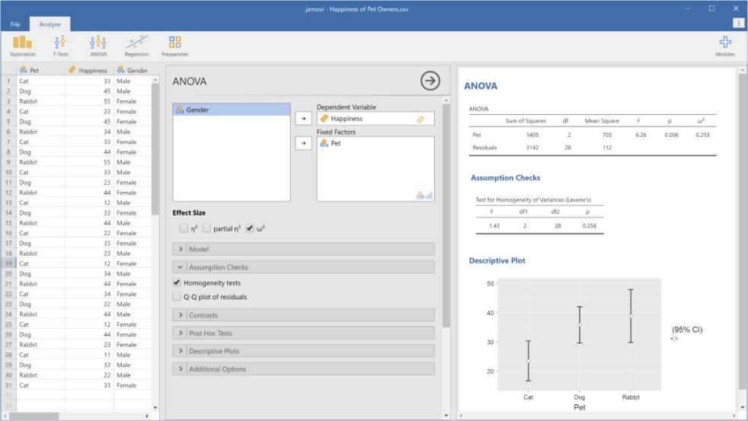
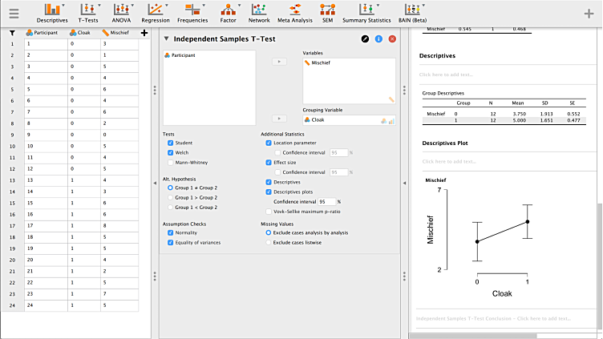
Pourquoi R ?
Gratuit
Alternatives gratuites mais « clic-bouton »
JAMOVI
JASP
Possibilité de sauvegarder la trace des opérations « clic-bouton » ! »
Compatible avec science ouverte
https://scholar.google.com/scholar?hl=fr&as_sdt=0%2C5&as_ylo=2019&q=popularity+R+statistical+software&btnG=
https://www.ncbi.nlm.nih.gov/pmc/articles/PMC7872865/pdf/cureus-0013-00000012639.pdf
À peu près 11000 articles
https://www.ncbi.nlm.nih.gov/pmc/articles/PMC10090872/pdf/rsos.221550.pdf#bmk_RSOS221550C23
https://flowingdata.com/2016/03/22/comparing-ggplot2-and-r-base-graphics/

Slide 10
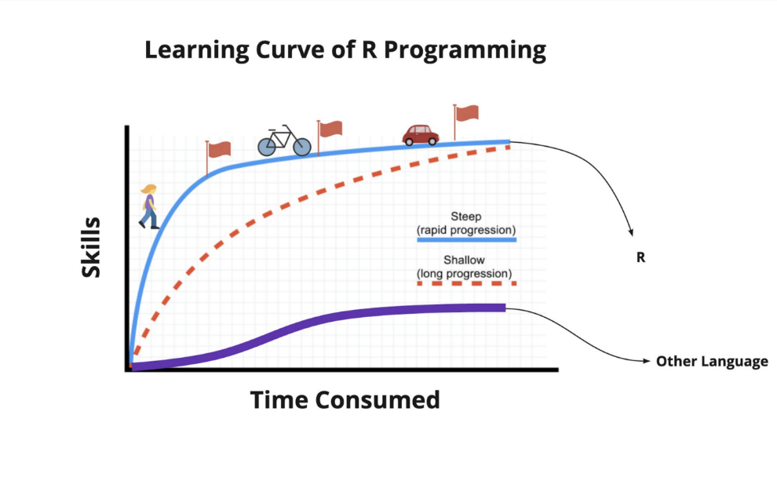
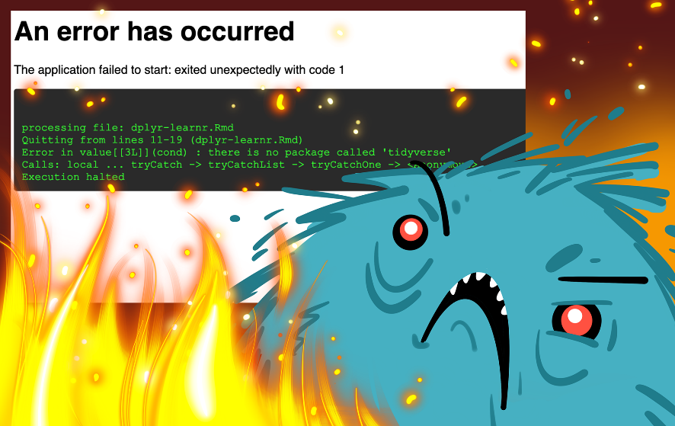
Pourquoi R ?
Avantages et inconvénients de R vs logiciels clic-bouton
 | R | JAMOVI/JASP | SPSS
Difficulté | +++ ? | + | +
Frustration | +++ | + | +?
https://slidemodel.com/templates/5-scale-emoji-feedback-powerpoint-template/
https://jamanetwork.com/journals/jama/fullarticle/2752474
The identified programming error […] occurred while the variable referring to the study “arm” (ie, group) assignment was recoded. The purpose of the recoding was to change the randomization assignment variable format of “1, 2” to a binary format of “0, 1.” However, the assignment was made incorrectly and resulted in a reversed coding of the study groups …
[…] As noted here, this reanalysis showed reversed study findings […]

Slide 11



Pourquoi R ?
Avantages et inconvénients de R vs logiciels clic-bouton
 | R | JAMOVI/JASP | SPSS
Science ouverte / reproductibilité | +++ | +++ | +
Prix | Gratuit | Gratuit | Payant
Champ des possibles | +++ | + | +?
Graphiques | +++ | ++ | +?
Documentation | +++ | ++ | +
https://slidemodel.com/templates/5-scale-emoji-feedback-powerpoint-template/
https://jamanetwork.com/journals/jama/fullarticle/2752474
The identified programming error […] occurred while the variable referring to the study “arm” (ie, group) assignment was recoded. The purpose of the recoding was to change the randomization assignment variable format of “1, 2” to a binary format of “0, 1.” However, the assignment was made incorrectly and resulted in a reversed coding of the study groups …
[…] As noted here, this reanalysis showed reversed study findings […]

Slide 12
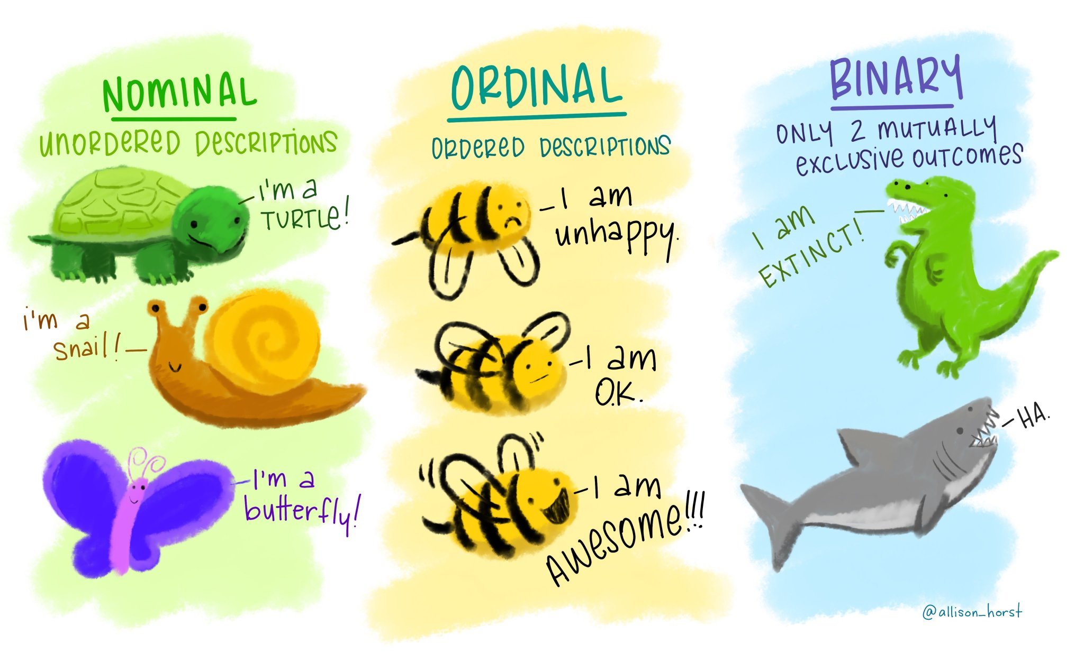
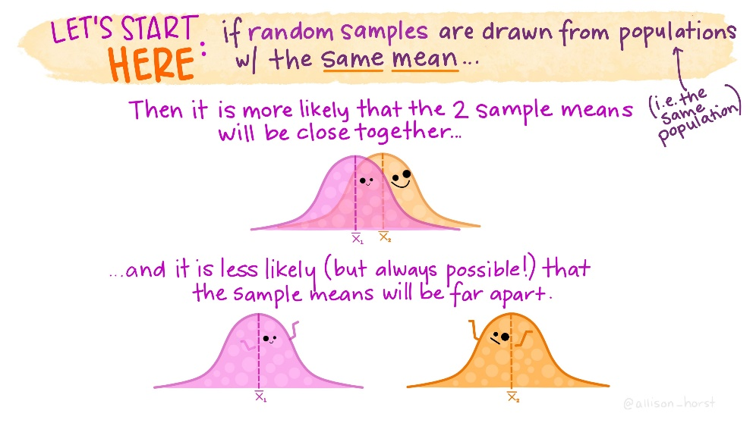
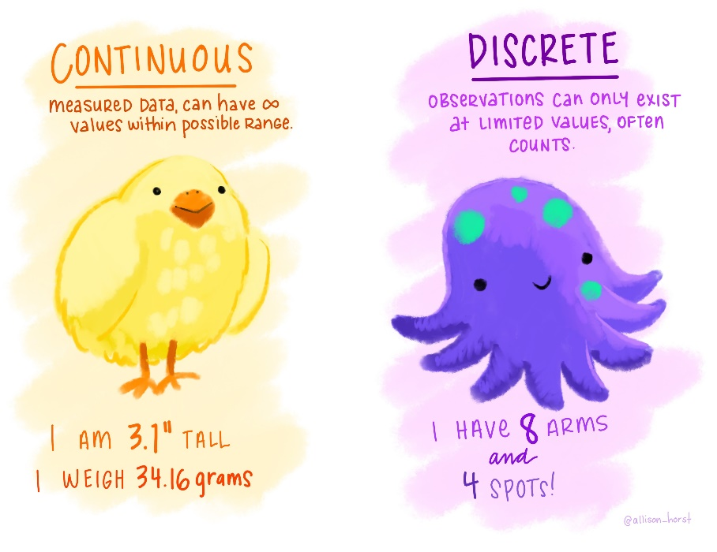
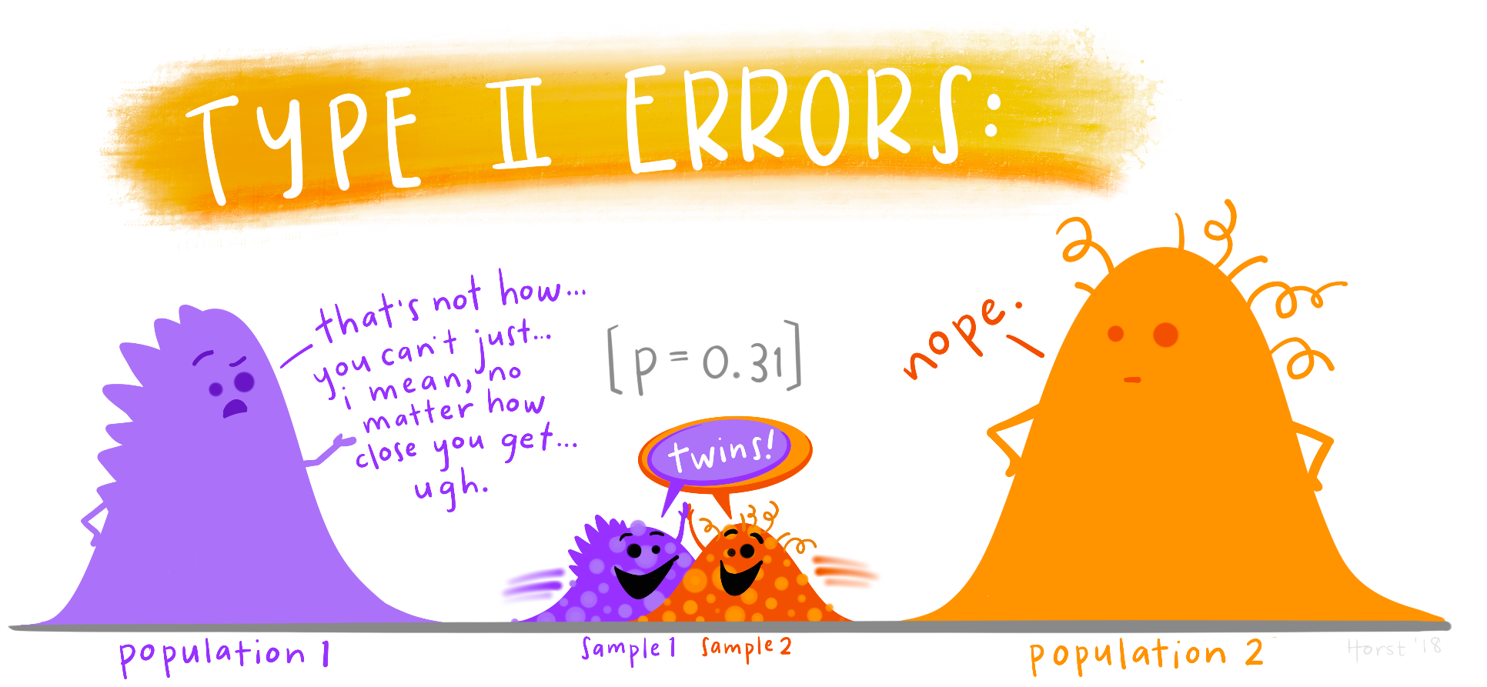
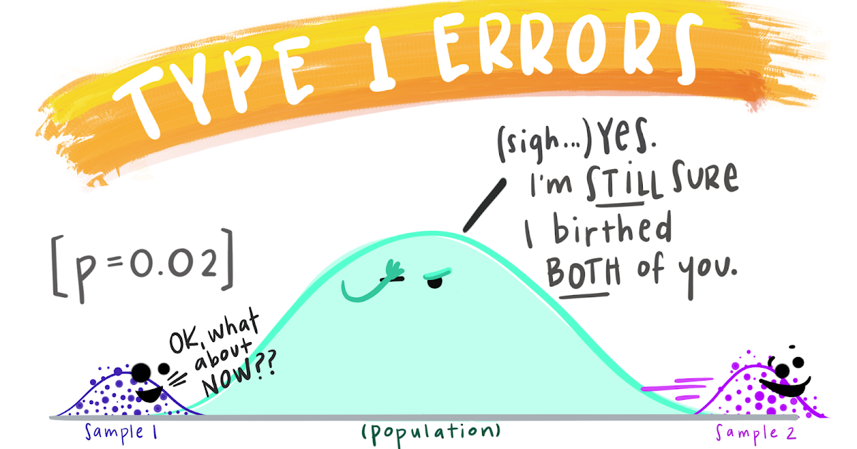
https://www.google.com/url?sa=i&url=https%3A%2F%2Fflowingdata.com%2F2022%2F10%2F24%2Feducational-statistics-illustrations%2F&psig=AOvVaw0VA0kaxQrM8W2DKyUTEM7G&ust=1694701705268000&source=images&cd=vfe&opi=89978449&ved=0CBAQjRxqFwoTCLi-5vnlp4EDFQAAAAAdAAAAABAT
https://www.google.com/url?sa=i&url=https%3A%2F%2Ftwitter.com%2Fallison_horst%2Fstatus%2F1216411207223009280&psig=AOvVaw1ntuCK61c2o0JgLcyruwKW&ust=1694701902714000&source=images&cd=vfe&opi=89978449&ved=0CBAQjRxqFwoTCMiL8dfmp4EDFQAAAAAdAAAAABAJ
https://www.google.com/url?sa=i&url=https%3A%2F%2Ftwitter.com%2Fallison_horst%2Fstatus%2F1317869593692569600&psig=AOvVaw1ntuCK61c2o0JgLcyruwKW&ust=1694701902714000&source=images&cd=vfe&opi=89978449&ved=0CBAQjRxqFwoTCMiL8dfmp4EDFQAAAAAdAAAAABAE
https://www.google.com/url?sa=i&url=https%3A%2F%2Ftwitter.com%2Fallison_horst%2Fstatus%2F1303929033604780032&psig=AOvVaw0VA0kaxQrM8W2DKyUTEM7G&ust=1694701705268000&source=images&cd=vfe&opi=89978449&ved=0CBAQjRxqFwoTCLi-5vnlp4EDFQAAAAAdAAAAABAb

Slide 13


TD 2 17/11/2023 Statistiques descriptives sur R
https://allisonhorst.com/r-slack-emoji

Slide 14
TD 3 24/11/2023 Statistiques inférentielles sur R (1)

